Slide 1
Fossil Energy Crosscutting Research
November 9, 2016

Slide 2
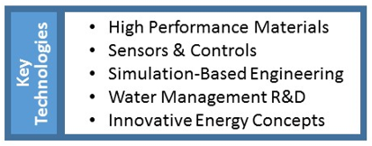
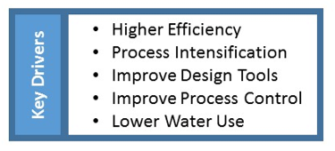
Crosscutting Research and Analysis
Targets Support Across Multiple Program Areas

Slide 3
Crosscutting Research and Analysis
Bridging the gap between fundamental research and applied development
to support advancement and utilization of domestic energy resources.
Crosscutting Research Focuses on Enabling Technologies that apply across multiple platforms
Crosscutting science, tools, and technology development program is supported by Industry
Has a 15-25 year horizon for technology that supports breakthrough concepts, addresses gaps, develops products with commercial application – near-term and long-term
Innovation through fundamental and applied developments that benefit Fossil-based Energy Systems (largely coal focused)
High Performance Materials
Sensors and Controls
Simulation-Based Engineering
Water Management
Innovative Energy Concepts
University Training and Research (UTR)

Slide 4
Crosscutting Technology Research

Slide 5
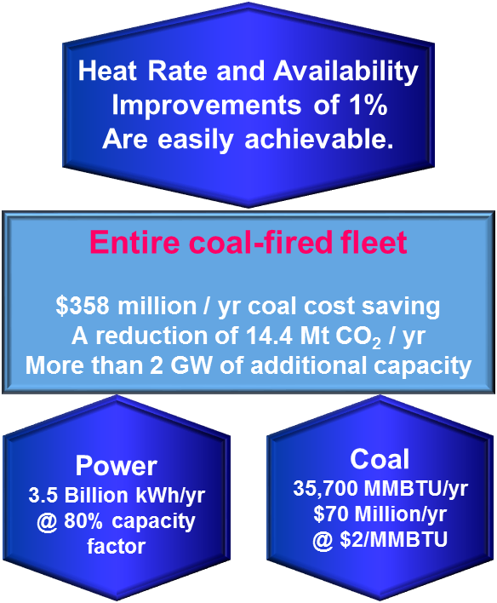
Crosscutting Research and Analysis
Improving HEAT RATE by 1%
Refurbishing the U.S. coal-fired fleet with improved technologies and optimal controls has the potential to reduce CO₂ emissions by over 14.4 million metric tons per year for every 1% heat rate improvement
Results in low cost per ton of CO2 avoided — $2-$10/mt CO₂
Increasing AVAILABILITY by 1 %
For example, sensors and controls technology has potential to reduce forced outages by 10% and making it economical for the coal fleet to refurbish at capital cost under $1 million
500 MW coal-fired units could produce an additional 44 million kWh/yr in added generation for each 1% improvement in availability, resulting in ≈$2.6 million/yr in sales (@ 6 cents/kWh)

Slide 6
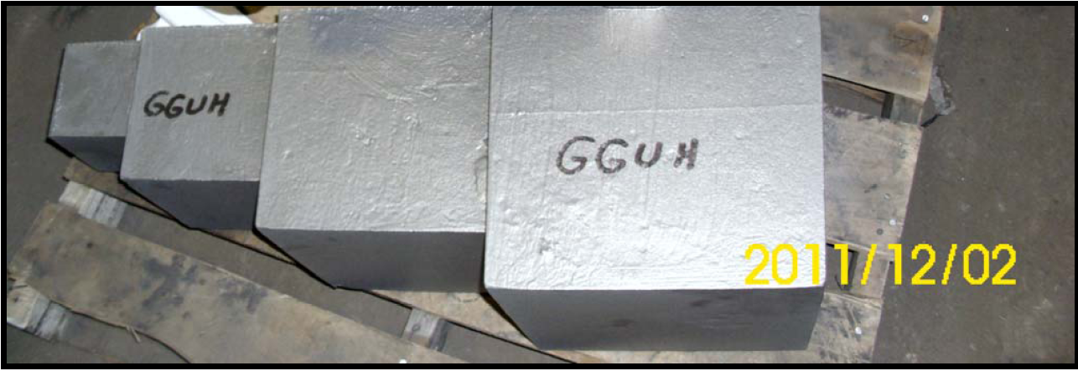
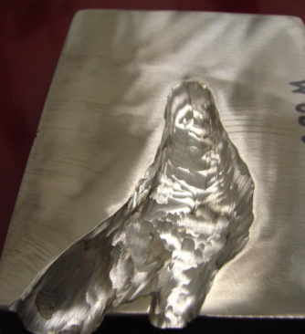
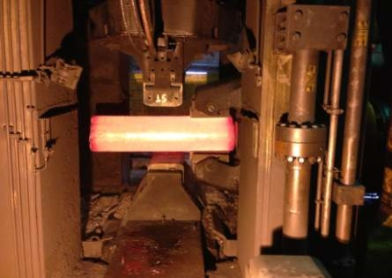
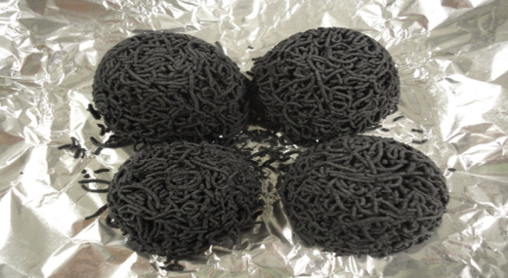
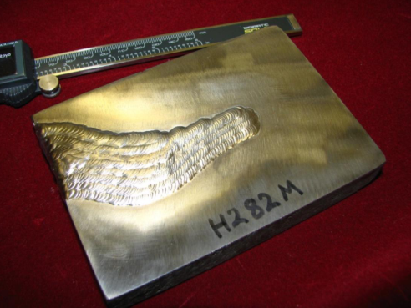
Crosscutting Research and Analysis
High Performance Materials Program
Design,
Fabricate and
Test
Structural
Functional Materials
Advanced Manufacturing
Computational Materials Design
Haynes 282 and Alloy 263 Step Castings 135-450kg sizes (300 to 1,000 lbs)
300mm³
Simulated casting weld defect repair
Oxygen Carrier Pellets for Chemical Looping Prepared from Extrusions (University of Toledo)
World’s First Haynes 282 Triple Melt Ingot

Slide 7
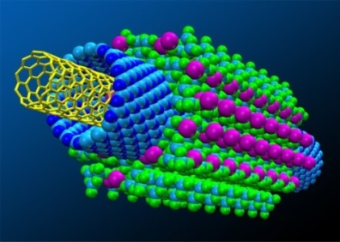
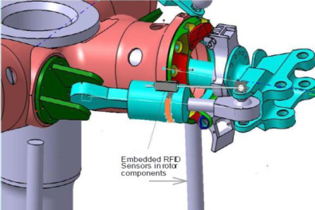
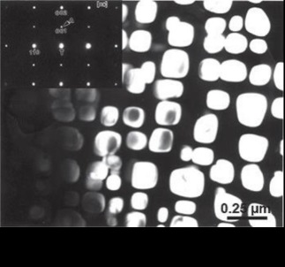
Advanced Manufacturing Technologies
Next Generation Materials
Advanced Materials
Membranes
Catalysts
Material Genome Initiative
Advanced Sensors
Advanced Coatings
Next Generation Electronics
Improved Manufacturing Systems
Smart Manufacturing
Automation and Robotics
Simulation and Visualization
Sustainable Manufacturing
Next Generation Manufacturing Processes
Additive Manufacturing
Nanomanufacturing
Bio-manufacturing
Modular Process Intensification
Roll-to-Roll Processing
50% of NETL Projects w/Advanced Manufacturing Concepts are Crosscutting Projects

Slide 8
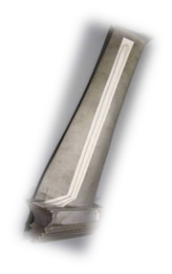
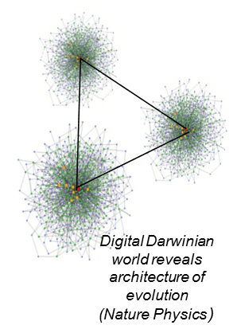
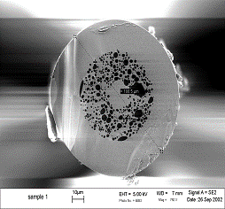
Sensors & Controls
Transformational Development for Online Monitoring and Process Control
Faster Response, Improved Knowledge, Better Control
Advanced Sensing and Remote Monitoring
Harsh environment sensing concepts and approaches for low cost dense distribution of sensors
Exploration of Sensor Networking using Passive and Active Wireless communication, Thermoelectric and vibration energy harvesting approaches
Distributed Intelligence
Computationally driven approaches for novel control architectures and logic, information generation, sensor networking & placement
Manage complexity inherent to Advanced Systems
Achieve Performance with Competing Objectives
Advanced Manufacturing Sensors
Pressure, Strain, Temperature, Impedance Defect
Basis for integrating sensors into systems, and
Integration of sensors into design and fabrication of components
AM techniques to lower cost and improve fabrication

Slide 9
Sensor & Controls R&D Areas

Slide 10
Simulation-Based Engineering for Technology Development

Slide 11
Water Management Research Focus Areas
Advanced / Novel Heat Transfer and Cooling Systems
Wet, Dry, Hybrid
Incremental & Step Change Improvements
Advanced Manufacturing of Recuperators for Combustion Turbines
Water Treatment and Reuse
Economic Pathways for Zero Liquid Discharge
Treatment of high TDS Waters (promote greater Water Reuse - collaboration with CS)
Process Efficiency and Heat Utilization
Pathways for produce more power per unit of water withdrawn, consumed, and treated
Utilization of Low-Grade Heat
Bottoming Cycles
Data, Modeling and Analysis
Tools to enable regional and plant level decision making
Develop a National Water Atlas
Breakthrough or Out of the Box
Low / No water FE based Systems, Distributed Generation, Grid Upgrades

Slide 12
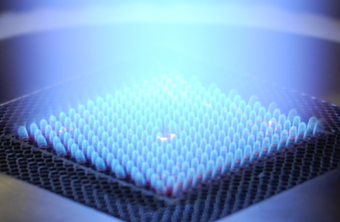
Innovative Energy Concepts
Incubator to Enable Advanced Transformative Technologies
Transformative improvements in Electricity Generation and Delivery
System Studies to validate concepts and understand economics of the technologies
Recent Studies:
Direct Power Extraction
Thermoelectric Materials
Pulse Detonation/Pressure Wave Combustion
Plant Flexibility Concepts
Conduct basic research to develop & validate computational tools
Expand basic research to improve critical components for technology to reach potential

Slide 13
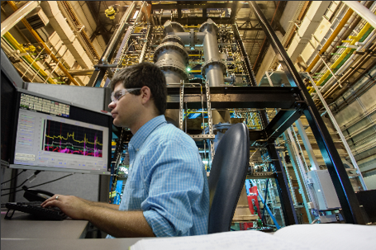
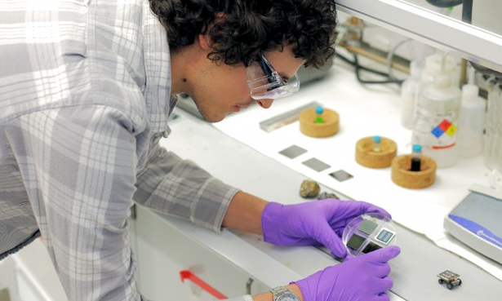
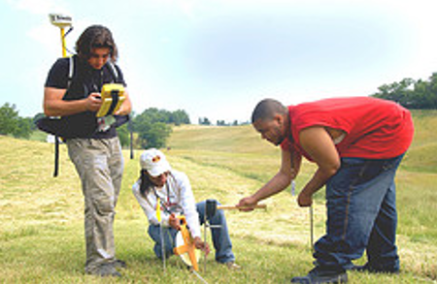
Educational Grant Programs Annual Solicitation for Fossil Energy Related Research
University Coal Research (UCR)
Sustain a national university program of fossil energy research that focuses on innovative and fundamental investigations pertinent to fossil fuel conversion and utilization
Provide a future supply of scientists and engineers through research exposure in clean energy fossil technologies
Improve our fundamental scientific and technical understanding of chemical and physical processes involved in the conversion and utilization of fossil fuels
Historically Black Colleges & Universities and Other Minority Institutions
Provide and promote opportunities for HBCU/OMI in science and engineering.
Foster private sector participation and interaction with HBCU/OMI in fossil energy­ related programs.
Provide a forum to facilitate technology transfer, strengthen educational training, and develop/enhance the research infrastructure capabilities of HBCU/OMI.

Slide 14
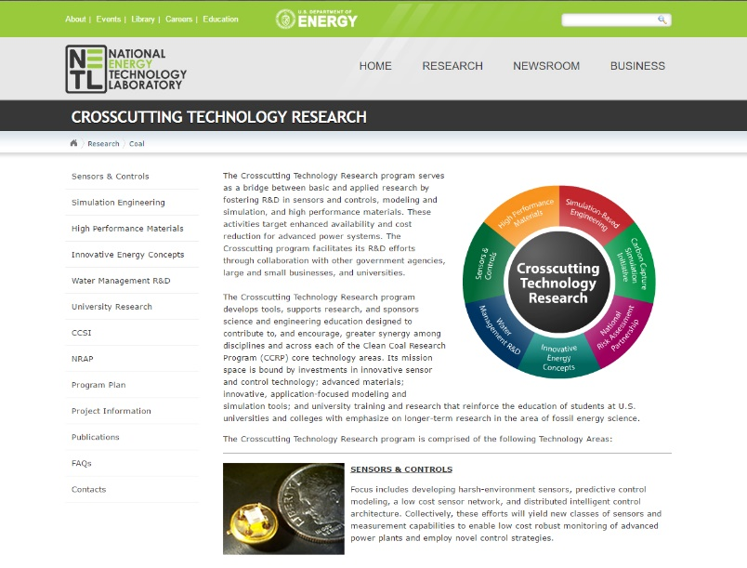
Useful Links
NETL www.netl.doe.gov
Office of Fossil Energy www.fe.doe.gov
Project Portfolios/Publications http://www.netl.doe.gov/research/coal/crosscutting/publications
Crosscutting Research http://www.netl.doe.gov/research/coal/crosscutting
Project Information http://www.netl.doe.gov/research/coal/crosscutting/project-information

Slide 15
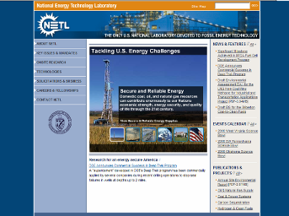
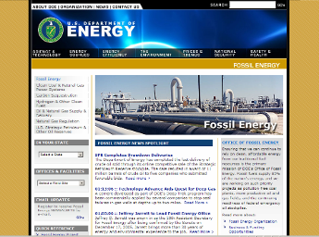
Contact Information
Robert R. Romanosky
304-285-4721
Robert.Romanosky@netl.doe.gov
Richard Dunst
412-386-6694
Dunst@netl.doe.gov

